Slide 1

The Longest Common Substring by Dynamic Programming
Presented by
Mariam Mamdouh Saady
212219

Slide 2
TABLE OF CONTENTS
01
02
03
04
INTRODUCTION
Strateegy
Problem Definition with the aim of the project
The way that we can follow to reach to the objective
Algorithm & Implementation
Analysis
Basic Mathematics Equations that the project built on it

Slide 3
01
INTRODUCTION

Slide 4
Definition of Longest Common SubString (LCS)
It involves identifying the longest sequence of characters or elements that appear in the same order within two or more strings.

Slide 5
Difference between longest common subsequence & longest common substring

Slide 6
Longest Common Substring
Definition | The longest common substring between two strings is the longest continuous sequence of characters that appears in the same order in both strings.
Example | String 1 | A | B | C | D
 | String 2 | A | C | D | X
Result | Common Substring is : “A” &“CD” &“D”
Longest is : “CD”

Slide 7
Longest Common Subsequence
Definition | The longest common subsequence between two strings is the longest sequence of characters that appear in the same relative order (not necessarily contiguous) in both strings.
Example | String 1 | A | B | C | D
 | String 2 | A | C | D | X
Result | Common Subsequence is : “ACD” or “CD” or “D”
Longest is : “ACD”

Slide 8
Strategy
02

Slide 9
“
—Logic
The strategy involves using dynamic programming to solve the problem efficiently. Dynamic programming can be used to build a table that stores the lengths of the longest common substring ending at each pair of indices in the input strings.

Slide 10
Problem Definition
String 1 = “ABCDEF”
 | A | B | C | D | E | F
X
Y
B
C
D
E
Z
String 2 = “XYBCDEZ”
-Firstly, we are going to make a 2D matrix array

Slide 11
Problem Definition
String 1 = “ABCDEF”
 | A | B | C | D | E | F
X | 0 | 0 | 0 | 0 | 0 | 0
Y
B
C
D
E
Z
String 2 = “XYBCDEZ”
-Firstly, we are going to make a 2D matrix array
- If the characters match: Fill that cell in the table with one plus the value from the cell diagonally above
- If characters do not match, set the value in the cell equal ZERO

Slide 12
Problem Definition
String 1 = “ABCDEF”
 | A | B | C | D | E | F
X | 0 | 0 | 0 | 0 | 0 | 0
Y | 0 | 0 | 0 | 0 | 0 | 0
B
C
D
E
Z
String 2 = “XYBCDEZ”
-Firstly, we are going to make a 2D matrix array
- If the characters match: Fill that cell in the table with one plus the value from the cell diagonally above
- If characters do not match, set the value in the cell equal ZERO

Slide 13
Problem Definition
String 1 = “ABCDEF”
 | A | B | C | D | E | F
X | 0 | 0 | 0 | 0 | 0 | 0
Y | 0 | 0 | 0 | 0 | 0 | 0
B | 0 | 1 | 0 | 0 | 0 | 0
C
D
E
Z
String 2 = “XYBCDEZ”
-Firstly, we are going to make a 2D matrix array
- If the characters match: Fill that cell in the table with one plus the value from the cell diagonally above
- If characters do not match, set the value in the cell equal ZERO

Slide 14
Problem Definition
String 1 = “ABCDEF”
 | A | B | C | D | E | F
X | 0 | 0 | 0 | 0 | 0 | 0
Y | 0 | 0 | 0 | 0 | 0 | 0
B | 0 | 1 | 0 | 0 | 0 | 0
C | 0 | 0 | 2 | 0 | 0 | 0
D
E
Z
String 2 = “XYBCDEZ”
-Firstly, we are going to make a 2D matrix array
- If the characters match: Fill that cell in the table with one plus the value from the cell diagonally above
- If characters do not match, set the value in the cell equal ZERO

Slide 15
Problem Definition
String 1 = “ABCDEF”
 | A | B | C | D | E | F
X | 0 | 0 | 0 | 0 | 0 | 0
Y | 0 | 0 | 0 | 0 | 0 | 0
B | 0 | 1 | 0 | 0 | 0 | 0
C | 0 | 0 | 2 | 0 | 0 | 0
D | 0 | 0 | 0 | 3 | 0 | 0
E
Z
String 2 = “XYBCDEZ”
-Firstly, we are going to make a 2D matrix array
- If the characters match: Fill that cell in the table with one plus the value from the cell diagonally above
- If characters do not match, set the value in the cell equal ZERO

Slide 16
Problem Definition
String 1 = “ABCDEF”
 | A | B | C | D | E | F
X | 0 | 0 | 0 | 0 | 0 | 0
Y | 0 | 0 | 0 | 0 | 0 | 0
B | 0 | 1 | 0 | 0 | 0 | 0
C | 0 | 0 | 2 | 0 | 0 | 0
D | 0 | 0 | 0 | 3 | 0 | 0
E | 0 | 0 | 0 | 0 | 4 | 0
Z
String 2 = “XYBCDEZ”
-Firstly, we are going to make a 2D matrix array
- If the characters match: Fill that cell in the table with one plus the value from the cell diagonally above
- If characters do not match, set the value in the cell equal ZERO

Slide 17
Problem Definition
String 1 = “ABCDEF”
 | A | B | C | D | E | F
X | 0 | 0 | 0 | 0 | 0 | 0
Y | 0 | 0 | 0 | 0 | 0 | 0
B | 0 | 1 | 0 | 0 | 0 | 0
C | 0 | 0 | 2 | 0 | 0 | 0
D | 0 | 0 | 0 | 3 | 0 | 0
E | 0 | 0 | 0 | 0 | 4 | 0
Z | 0 | 0 | 0 | 0 | 0 | 0
String 2 = “XYBCDEZ”
-Firstly, we are going to make a 2D matrix array
- If the characters match: Fill that cell in the table with one plus the value from the cell diagonally above
- If characters do not match, set the value in the cell equal ZERO
- Once the matrix is filled, find the maximum value in the matrix. Which is here is 4
- Trace back from this maximum value in the matrix to reconstruct the longest common substring.
- Starting from the cell with the highest value, move diagonally upwards while the cell values decrease by 1 each time. Record each character you encounter during this process.
- BCDE

Slide 18
Algorithm & Implementation
03

Slide 19







Steps to Follow

Slide 20
Steps to Follow
Create a 2D table to store the lengths of the longest common substring.

Slide 21
Steps to Follow
Initialize the table with zeros.
Iterate through both strings and compare characters.

Slide 22
Steps to Follow
If the characters at the current indices match, update the value in the table to be one plus the value in the table for the previous indices.

Slide 23
Steps to Follow
Track the maximum length of the common substring

Slide 24
Steps to Follow
Return the maximum length found in the table.

Slide 25
Steps to Follow
Extract the longest common substring using the ending index and maximum length.

Slide 26
Steps to Follow

Slide 27
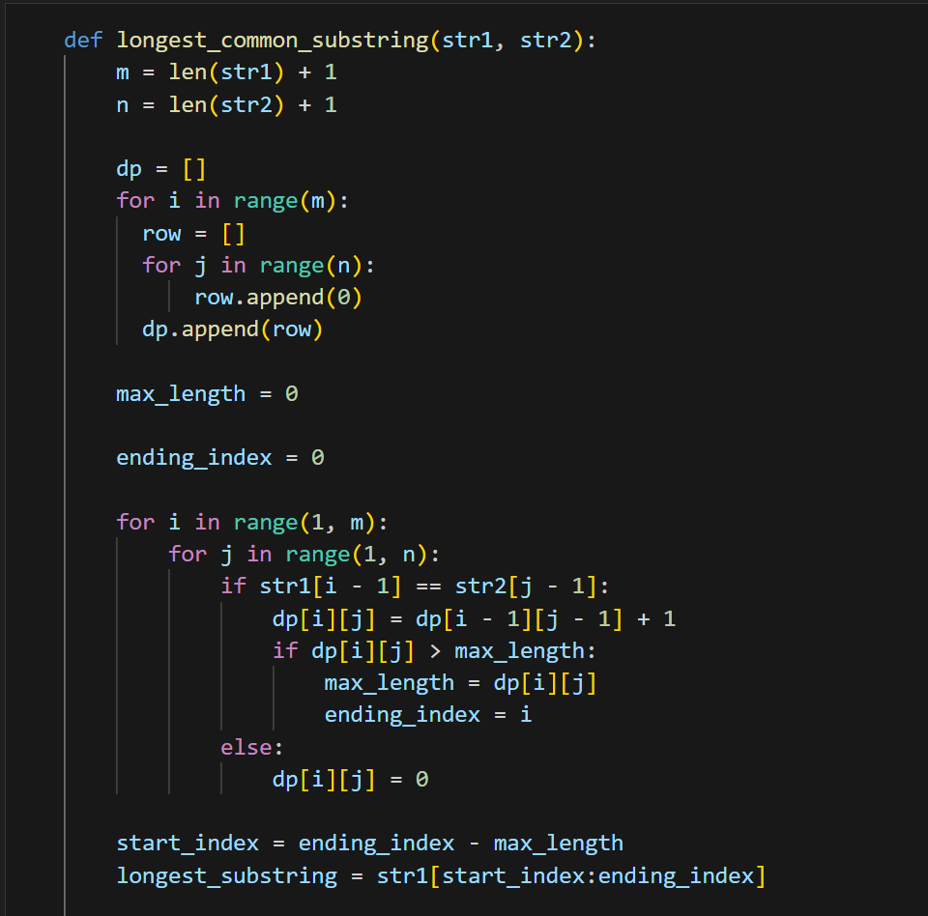
Doing the Implementation

Slide 28
Analysis!
04

Slide 29




Doing the Math!
$$T\left(m,n\right)= \sum_{i=1}^{m−1}{\sum_{j=1}^{n−1}{1}}$$
Step 1
$$T\left(m,n\right)=\sum_{i=1}^{m−1}{(\sum_{j=1}^{n−1}{1})}$$
Step 2
$$T\left(m,n\right)= \sum_{i=1}^{m−1}{(n−1)}$$
Step 3
Step 4
$$T\left(m,n\right)=\left(m−1\right)∗ (n−1)$$

Slide 30



Doing the Math!
Step 5
$$T\left(m,n\right)=O\left(m−1\right)∗ O(n−1)$$
Step 6
$$T\left(m,n\right)=O\left(m\right)∗ O(n)$$
Step 7
$$T\left(m,n\right)=O(m∗n)$$

Slide 31
RESOURCES
https://www.youtube.com/watch?v=UZRkpGk943Q
https://www.youtube.com/watch?v=BysNXJHzCEs
https://en.wikipedia.org/wiki/Longest_common_substring

Slide 32
THANKS!
Do you have any questions?
mariam.mamdouh4@msa.edu.eg
Please keep this slide for attribution

